Slide 1



Benefits of CI/CD

Slide 2


agenda
What Is CI/CD?
Differences Between Continuous Integration, Continuous Delivery, and Continuous Deployment?
How Does CI/CD Relate to DevOps?
Stages of a CI/CD Pipeline
CI/CD Tools ​

Slide 3


What is CI/CD
Continuous Integration and Continuous Delivery/Deployment (CI/CD) is a software engineering practice that automates application build, testing, and deployment. CI/CD practices form the backbone of modern DevOps processes.
This process contrasts with the traditional approach to software development—consolidating multiple small software updates into one large release, thoroughly testing it, and only then deploying it. CI/CD pipelines support the agile concept of development in small iterations, enabling teams to deliver value to customers faster, and create a rapid feedback loop for developers.

Slide 4

Differences Between Continuous Integration, Continuous Delivery, and Continuous Deployment?
Click to add photo

Slide 5
Continuous Integration
Continuous Integration (CI) was designed to solve this problem and support agile development processes.
CI means that any changes developers make to their code are immediately integrated into the master branch of the software project.
The CI system automatically runs tests to catch quality issues, and developers get quick feedback and can fix issues immediately.
Developers often commit to the master branch or work on a short-lived feature branch, and a feature is not considered complete until it is integrated with other code changes in the master branch.

Slide 6
Continuous Delivery
Traditionally, deploying new software versions has been a large, complex and risky task.
Depending on the size of the software it could take hours, days or weeks, requires detailed checklists and many manual steps
The CI system automatically runs tests to catch quality issues, and developers get quick feedback and can fix issues immediately.
Continuous Delivery (CD, also known as CDel) aims to solve these problems through automation.
The CD approach allows teams to package software and deploy it to production environments with the push of a button.
The basic principle of CD is that any change to a software project can be deployed to a production environment immediately, without any special effort.

Slide 7
Continuous Deployment
Continuous Deployment (CDep) goes one step further than continuous delivery.
All changes going through all stages of the production pipeline undergo automated tests, and if these tests pass, they are immediately deployed to production and exposed to customers.
Continuous deployment can be difficult to implement.
It requires seamless automation at all stages of the process, robust automated testing suites, and a culture of “continuous everything” that enables detection and rapid response to production issues.

Slide 8

How Does CI/CD Relate to DevOps?
DevOps typically involves the following:
Adopting automation, programmable infrastructure deployment and maintenance, and iterative software development.
Establishing cross functional teams while facilitating a culture change to build trust between these previously disparate teams.
Aligning technologies to business requirements.

Slide 9
How Does CI/CD Relate to DevOps?
CI/CD supports the efforts of DevOps teams:
It enables teams to implement automation across the development lifecycle and rapidly validate and deliver applications to end-users. Here is how it works:
Continuous integration tools help initialize processes, ensuring developers can build, test, and validate code within a shared repository without manual work.
Continuous delivery tools extend these automated steps to production testing and configuration for release management.
Continuous deployment tools automatically invoke tests, handling configurations, provisioning, monitoring, and rollbacks.

Slide 10

What Are the Stages of a CI/CD Pipeline?

Slide 11
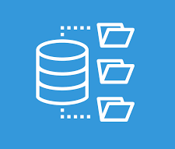
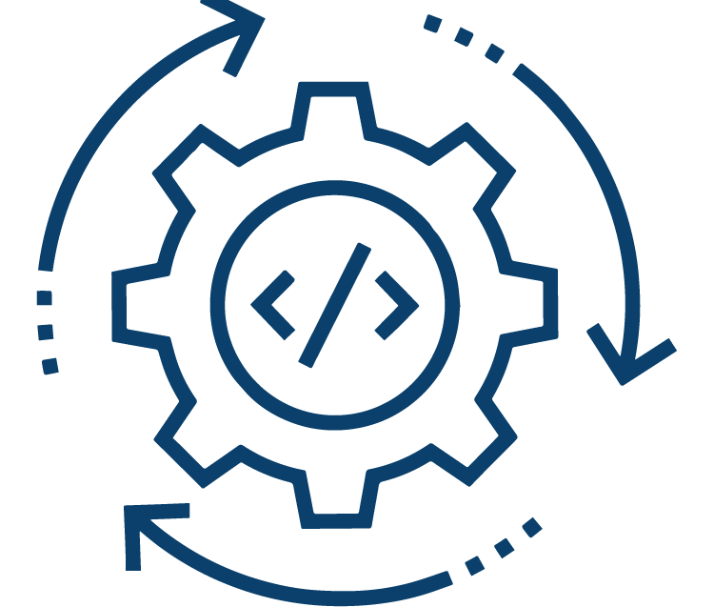

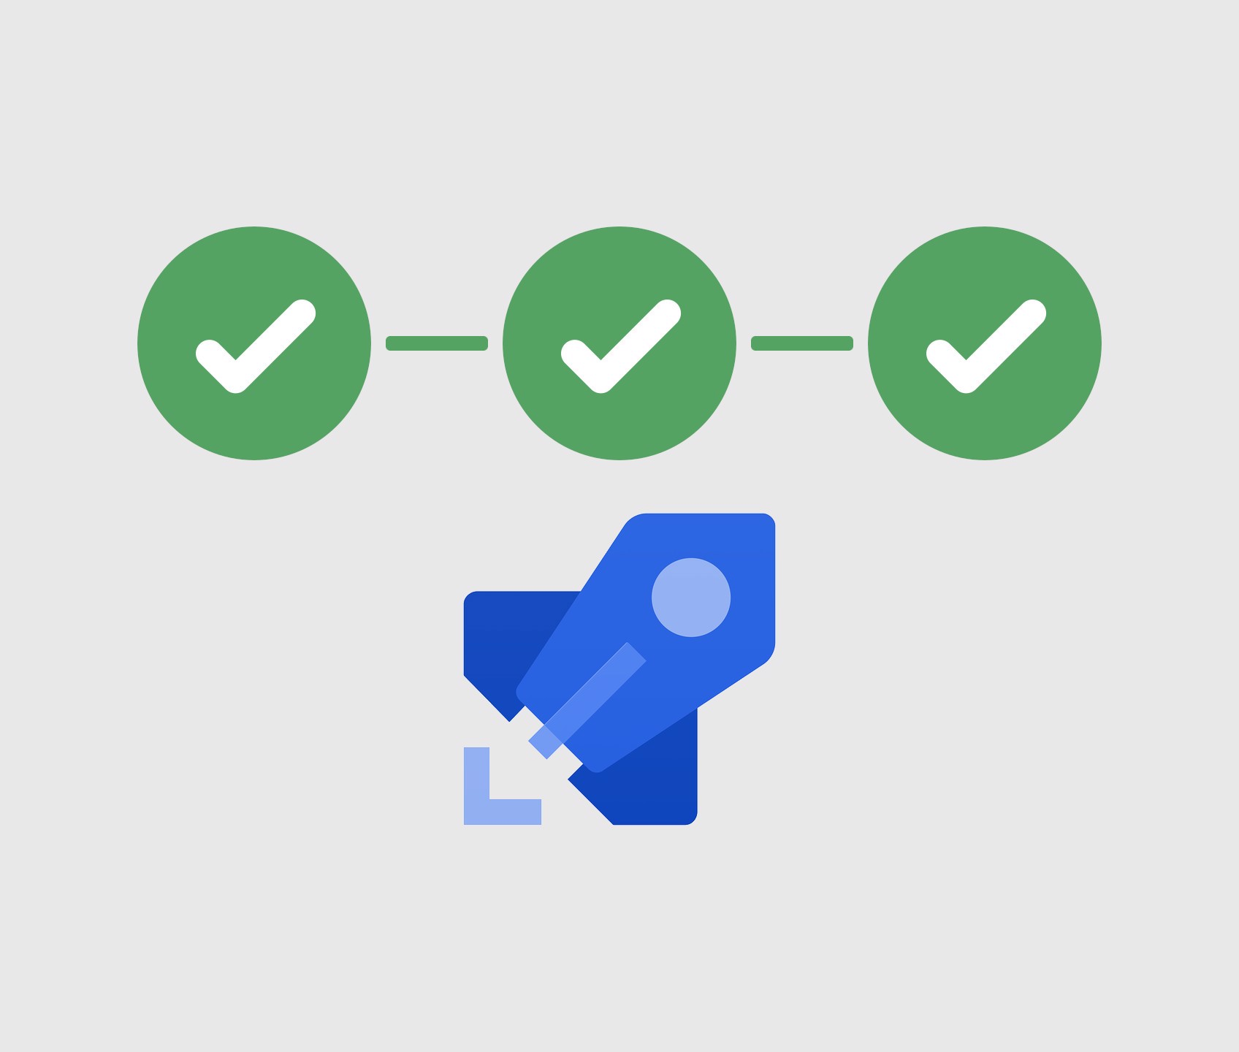
Ci/cd STAGES
The CI/CD pipeline performs continuous integration, delivery, and deployment in four phases:
source
build
test
deploy
Git and SVN or any code commit tools
Build source to executable file
Validate the executable file is running correctly
Deploy the executable file to the server

Slide 12
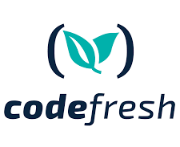




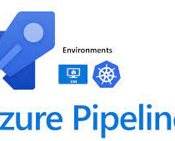


CI/CD Tools
Codefresh
bitbucket
JENKINS
circleci
CI/CD TOOL
CI TOOL
CI TOOL
CI TOOL
AWS Code pipeline
Azure Pipelines
Spinnaker
Go-CD
CD TOOL
CD TOOL
CD TOOL
CD TOOL

Slide 13
Thanks

